Slide 1
Secure Distributed File System
CMSC 626 Final Project : Spring 2023
Group 3

Slide 2
Introduction
This project's objective is to create a peer-to-peer (P2P) distributed file system, in which each peer serves as both a server and a client.
The project includes various functionalities such as file creation, deletion, read, write, replication, permission setting and key revocation.
The focus of the system is on maintaining the confidentiality and integrity of file contents.

Slide 3
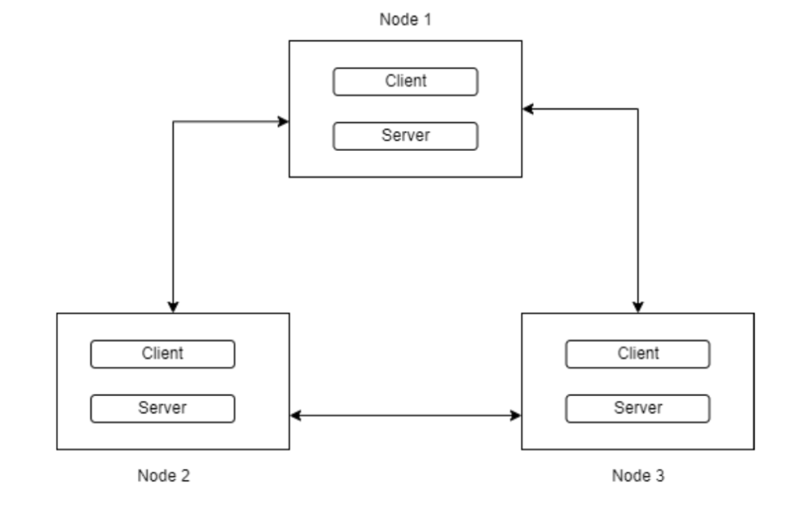
Project Design
To make the file system P2P while simplifying the efforts, the list of all the users is maintained on every node. This enables both the client and server to make further requests.
Each node will maintain a list of peers and their IP addresses. When a node joins the network, it will share its public keys with all other nodes in the network to ensure secure communication.

Slide 4
File operations
Create File
Read File
Write File
Replication
List Files
Delete File

Slide 5
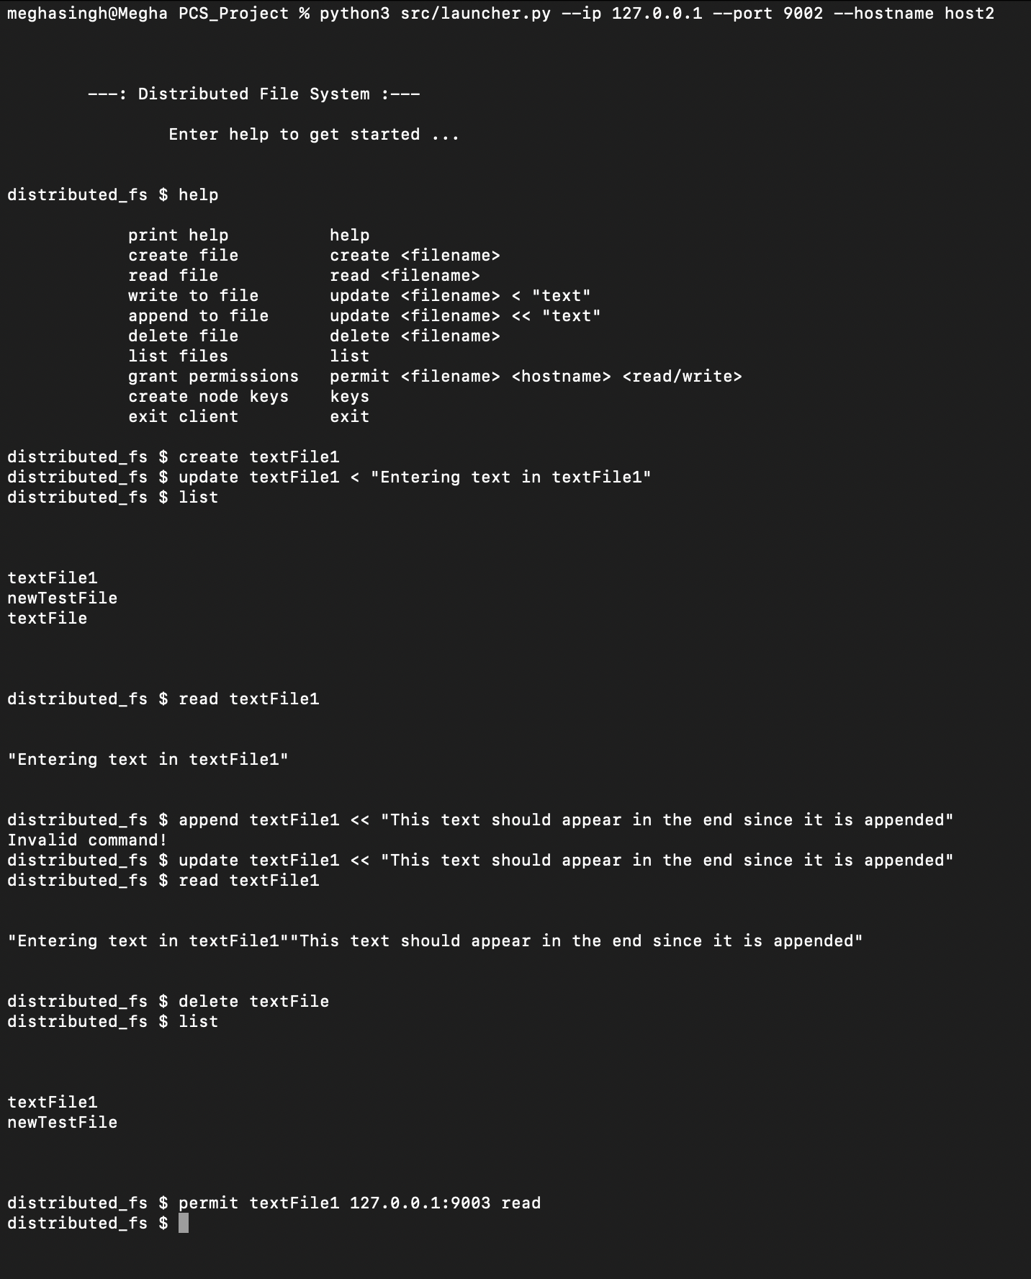
This image shows the client side of all the file operations.
The user is presented with the ‘help’ menu for entering commands.
The user performs the following operations :
creates a file : ‘textFile1’
lists all the files on the node
writes to the file, reads, appends
deletes a file ‘textFile’, list all files to check if the files was deleted
grants read permission to node 3.
This image also shows error message : “Invalid command” when the user enters wrong command.

Slide 6
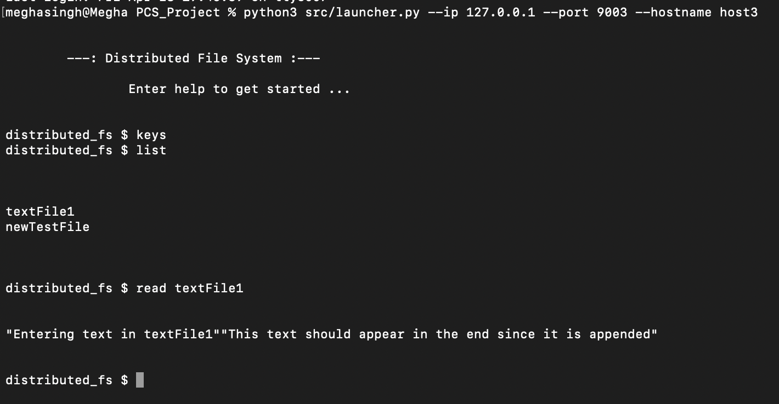
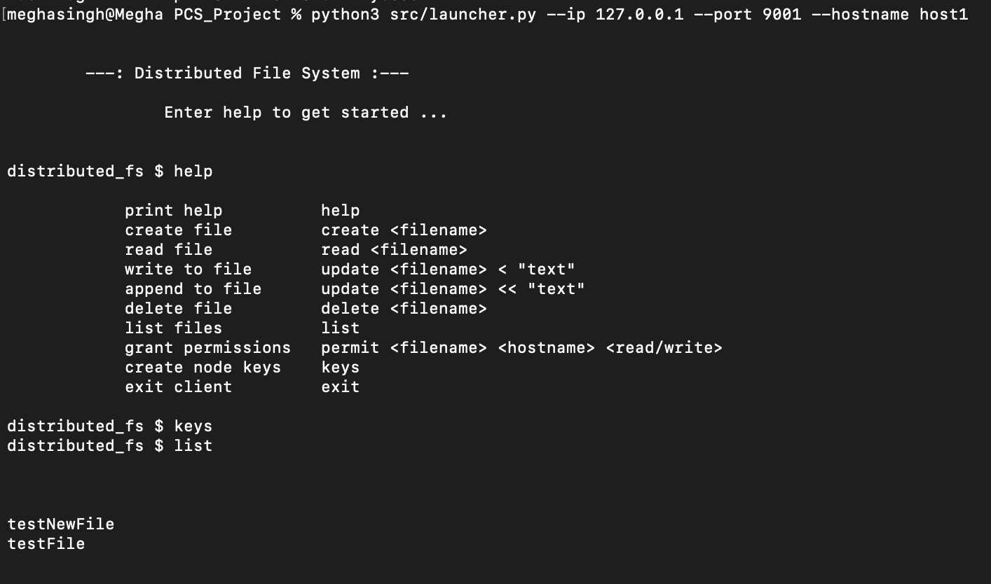
The first image shows that node 3 can list all files and read the file ‘textFile1’ from Node 2 for which the read permission was granted to it.
The second image shows that node 1 which was not given permission from node 2 cannot list its files.

Slide 7
Consistency
To display only the latest file content, load content up to the request processing time.
If a user modifies the file, other users must reload to see the changes.
Overall, the solution prioritizes displaying the most recent version of the file.

Slide 8
Permissions
The ability to grant permission for a file is restricted to the owner node.
Read Permission
To share read permission, owner node shares file's private key with recipient node.
Owner node encrypts private key using recipient node's public key for security, and recipient node keeps entry for shared file.
Write Permission
Owner node shares private and public keys with other node.
Other node can read and update file, and owner node updates it on all nodes.
Permission Revocation
To revoke any permission we need to regenerate RSA keys for the file. These new keys will then have to be shared with other nodes that have been given access.

Slide 9
Key Revocation
If a user requests to change the keys then all the read and write keys created with it are recomputed and updated.
Once these keys are updated the user can access all the content with the same privileges.
All nodes in the network can change their own RSA keys. After generating a new public key, the updated key is then distributed to all other nodes.

Slide 10
Concurrent Writes
Whenever a node wants to write to the file, it will have to obtain a lock from the owner node.
The lock will prevent any other nodes from writing to the file while it is being edited.
Once the write operation is completed, the lock will be released.

Slide 11
Security Considerations
To prevent unauthorized access or changes we designated the owner node to be responsible for replicating the content.
Other nodes can edit the file with permission, but updates are sent to the owner node.
The owner node replicates the changes to all other nodes to ensure that changes are authorized and propagated.
To verify the authenticity of the updated content, each node checks if the update was sent by the owner node using a digital signature.
Each node has the public key of all other nodes in the network, which enables this verification process.

Slide 12
Conclusion
The project includes a variety of features such as user key revocation, file sharing through a peer-to-peer network, and support for file creation, deletion, reading, writing, and restoration with at least three replicas.
The features that were implemented to make this distributed file system secure are permission management for files and directories, confidentiality of file and directory names, detection of unauthorized modifications, encrypted communication between peers, and detection of malicious file servers.

Slide 13
Thank you for your attention!

